Slide 1


Supply and Demand Gap Analysis
By Nitish varma

Slide 2



Introduction:
In this analysis, we explore the critical relationship between customer demand and driver availability within Uber's ride-hailing platform.
Understanding and effectively managing this gap is crucial for optimizing operations and enhancing the overall user experience.
Objective:
Our objective is to uncover insights and recommendations that bridge the supply and demand gap in the Uber ecosystem.
By analyzing comprehensive datasets and utilizing advanced analytics techniques, we aim to provide valuable strategies for operational excellence.
2

Slide 3
Methodology:
We have implemented thorough data collection methods and harnessed the capabilities of powerful analytical tools like Power BI to extract valuable insights from the data.
Our methodology includes data cleaning, exploratory data analysis, and visualization techniques to gain a comprehensive understanding of the supply and demand dynamics.
Deliverables:
Through this presentation, I will share key findings, actionable recommendations, and data-driven insights to help Uber optimize their operations and address the supply and demand challenges.
We believe that this analysis will provide valuable insights for Uber's strategic decision-making processes.
3

Slide 4
Disparity in Pickup Point Distribution:
Variations in Pickup Points by Status:
Daily Distribution in the City and the airport:
Address gap between city and airport demand.
Identify disruptions or unmet demand by status.
Optimize driver availability for fluctuating city and airport demand.
Problem statements-
Hourly Distribution in the City and at Airport:
Frequency of Time by Pickup Point and Status:
Frequency of Time by Status:
Allocate drivers effectively during peak city and Airport demand hours.
Balance supply and demand by considering time, location, and service disruptions.
Understand ride request distribution and optimize driver availability.
4

Slide 5

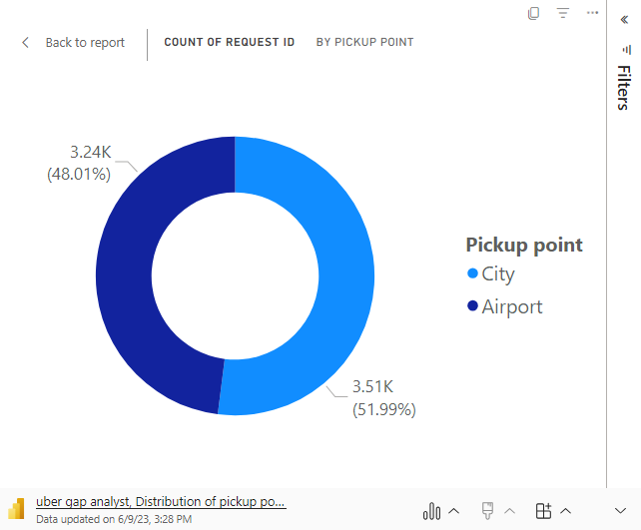
Distribution of Pickup Points
The total count of pickup points for City as 3.5k and for Airport as 3.2k.
Emphasize the importance of understanding the distribution of pickup points for effective resource allocation and service optimization.

Slide 6
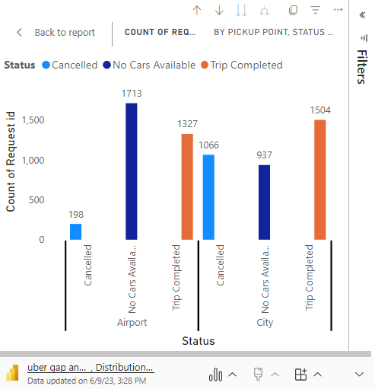
Distribution of Pickup Points based on Status
Airport has higher cancellation rates and instances of no cars available compared to the City.
Addressing the supply-demand gap at the Airport is crucial for improving customer satisfaction.
Efforts should be made to reduce cancellations and improve car availability in both locations.
6

Slide 7
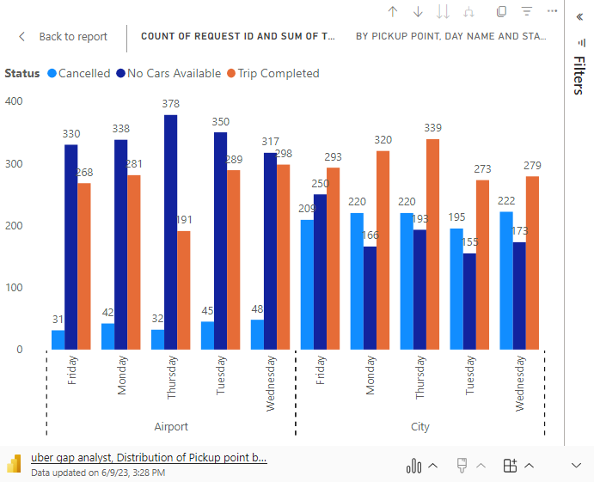
Distribution of Pickup Points based on Day
Consistent distribution patterns of pickup points based on weekdays.
Fridays have better supply-demand coordination with lower cancellations and unavailability of cars.
Mondays and Thursdays face challenges with higher cancellations and unavailability of cars.

Slide 8
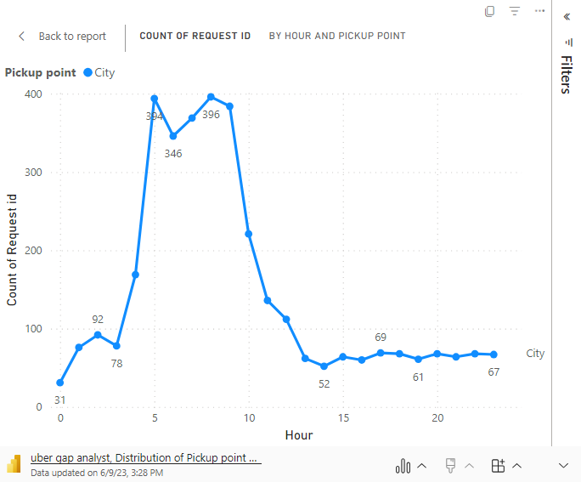
This period of lower demand can be considered a "daytime lull" for airport pickups, indicating a potential opportunity for drivers to focus on other areas or tasks during this time.
Distribution of Pickup Point CITY based on Hour of the Day
Peak demand for rides occurs during the morning commute around 8-9 AM.
Peak demand for rides occurs during the morning commute around 8-9 AM.
Another surge in demand is observed during the evening commute and post-work hours

Slide 9
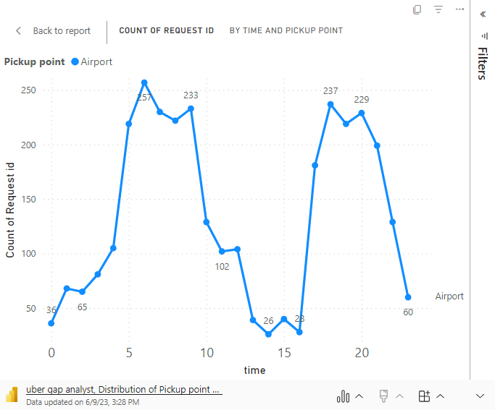
This period of lower demand can be considered a "daytime lull" for airport pickups, indicating a potential opportunity for drivers to focus on other areas or tasks during this time.
Distribution of Pickup Point Airport based on Hour of the Day
The chart reveals a noticeable decrease in the count of request IDs for airport pickups during the afternoon hours.
Specifically, there is a dip in demand between 12 PM and 4 PM, with the lowest point occurring around 2 PM.
This period of lower demand can be considered a "daytime lull" for airport pickups, indicating a potential opportunity for drivers to focus on other areas or tasks during this time.

Slide 10
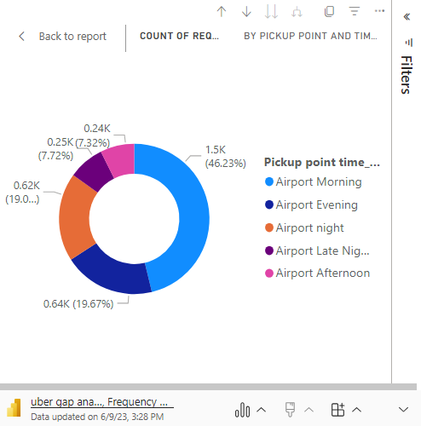
Frequency of Airport Pick-up Points based on Time of the Day and Status
Morning time: The most popular time period, indicating high demand in the morning.
Evening time: A significant time period with considerable demand during the evening hours.
Night and late-night Time: Both periods show notable demand during nighttime hours.
10

Slide 11
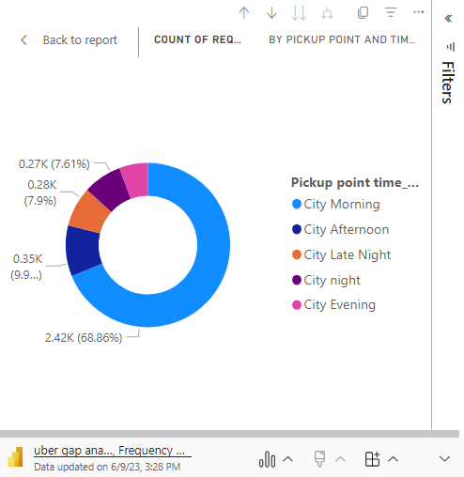
Frequency of City Pick-up Points based on Time of the Day and Status
Morning time: Most pickup requests in the city occur during the morning hours, indicating high demand.
Evening, Night, and Late nighttime: These time periods experience relatively lower pickup request volumes in the city.
11

Slide 12

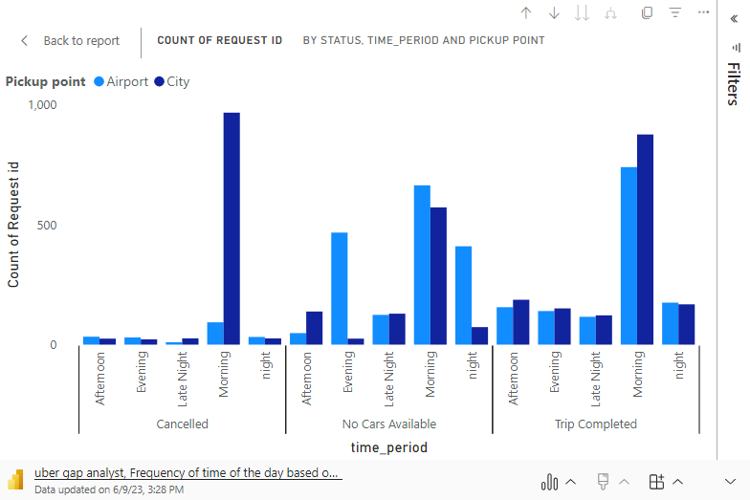
Frequency of time of the day based on pick up points and status
The Airport experiences a higher frequency of cancelled requests and instances of no cars available compared to the City, indicating potential service gaps that need to be addressed.
Trips completed at the Airport are generally higher in the morning, while the City shows more trip completions during the evening and afternoon periods.
The data suggests a need to focus on improving service availability and managing resources effectively to meet customer demand at both the Airport and City pickup points.
12

Slide 13
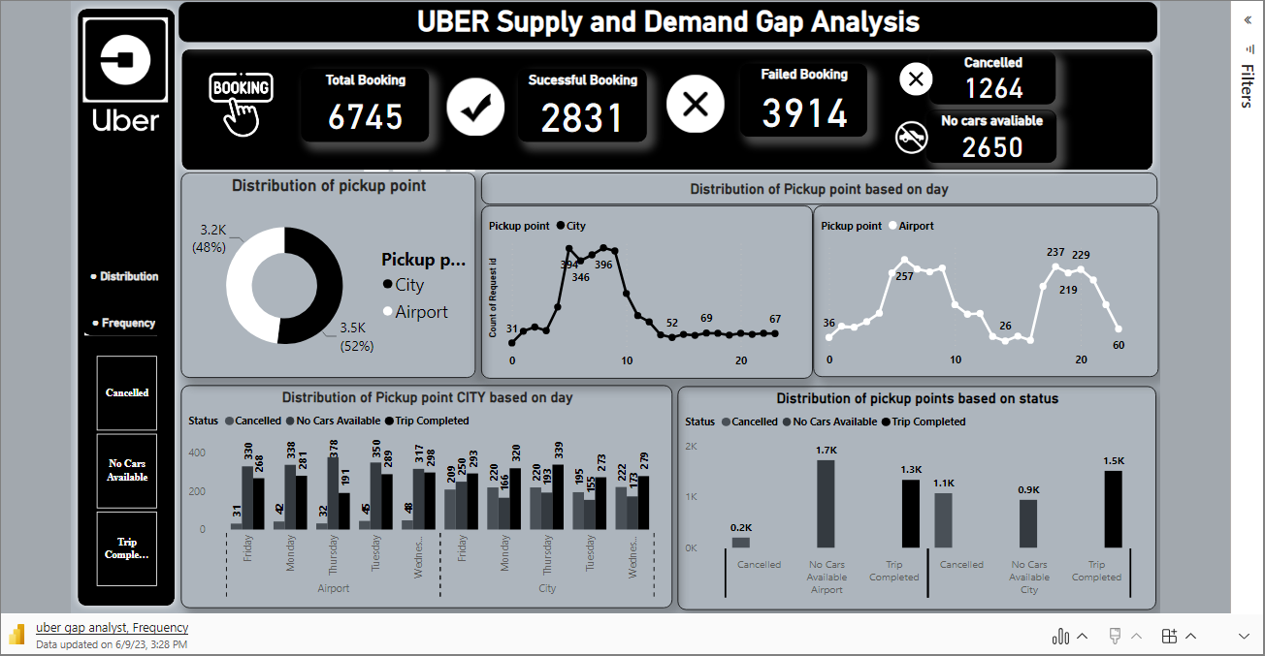
DASHBOARD

Slide 14
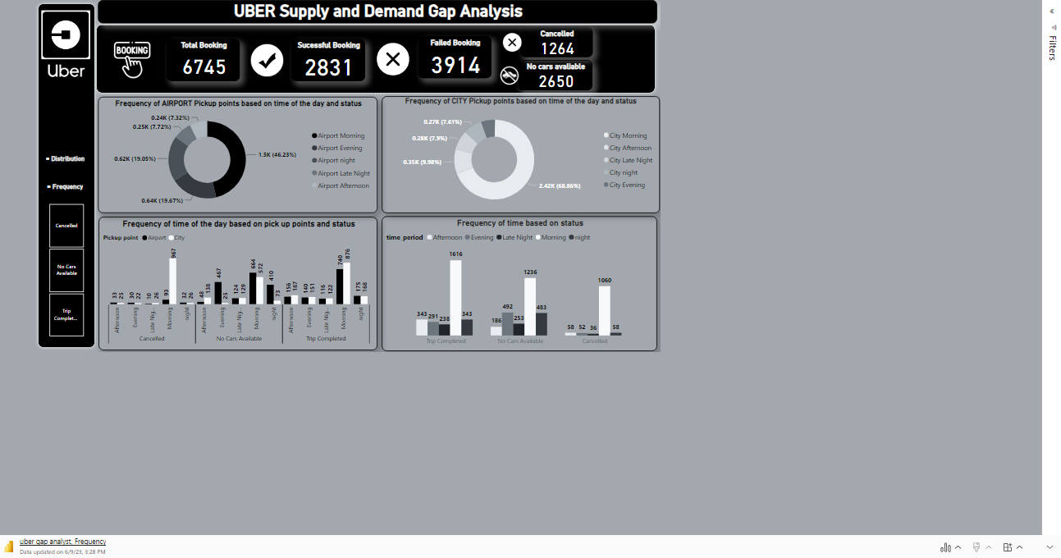
DASHBOARD

Slide 15




Demand
Supply-Demand Gap
Peak Times
City has higher pickup demand than Airport, highlighting the need for optimized resource allocation.
Airport faces more cancellations and unavailability of cars, necessitating attention to address the gap.
Mornings and evenings are peak pickup hours in both City and Airport, requiring sufficient car availability.
Day of Week
Airport Patterns
City Patterns
Thursdays have more cancellations in City, while Mondays show higher cancellations at Airport.
Early morning sees a surge in Airport pickups, indicating the need for adequate resources.
Morning hours in City have more cancellations and unavailability of cars, requiring improvement.
INSIGHTS
15

Slide 16

Increase car availability during peak hours and at the Airport
Address cancellations, especially in the morning and on Thursdays.
Address cancellations, especially in the morning and on Thursdays.
Address cancellations, especially in the morning and on Thursdays.
Monitor and adjust operations based on performance metrics.
Prioritize customer satisfaction for a seamless pickup experience.
RECOMMENDATIONS
16

Slide 17


CONCLUSION
In conclusion, the analysis of ride-sharing data provided valuable insights into pickup patterns and operational challenges. The Airport emerged as a key pickup point, requiring attention to address issues such as cancellations and car availability. Efforts should be focused on optimizing resources and ensuring a seamless pickup experience during peak morning hours.
Furthermore, variations in pickup patterns across different days highlight the need for dynamic resource allocation based on day-specific demand. By addressing supply-demand gaps, improving car availability, and reducing cancellations, ride-sharing companies can enhance customer satisfaction and loyalty.
In summary, leveraging these insights, ride-sharing companies can take proactive measures to optimize their service. By focusing on efficient resource management, improved communication, and addressing operational challenges, they can create a reliable and satisfying experience for riders, leading to increased customer loyalty and business success.

Slide 18
THANK YOU

